Slide 1
Machine Learning

Slide 2
What is Machine Learning?
Machine learning teaches computers to do what comes naturally to humans and animals: learn from experience.
Machine learning algorithms use computational methods to “learn” information directly from data without relying on a predetermined equation as a model.
The algorithms adaptively improve their performance as the number of samples available for learning increases.

Slide 3
More Data, More Questions, Better Answers
Machine learning algorithms find natural patterns in data that generate insight and help you make better decisions and predictions.
They are used every day to make critical decisions in medical diagnosis, stock trading, energy load forecasting, and more.
Media sites rely on machine learning to sift through millions of options to give you song or movie recommendations.
Retailers use it to gain insight into their customers’ purchasing behavior.

Slide 4
Real-World Applications
With the rise in big data, machine learning has become particularly important for solving problems in areas like these:
Computational finance, for credit scoring and algorithmic trading
Image processing and computer vision, for face recognition, motion detection, and object detection
Computational biology, for tumor detection, drug discovery, and DNA sequencing
Energy production, for price and load forecasting
Automotive, aerospace, and manufacturing, for predictive maintenance
Natural language processing

Slide 5
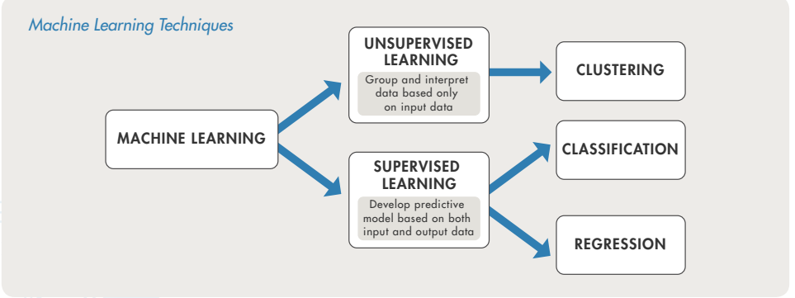
How Machine Learning Works

Slide 6
Supervised Learning
The aim of supervised machine learning is to build a model that makes predictions based on evidence in the presence of uncertainty.
A supervised learning algorithm takes a known set of input data and known responses to the data (output) and trains a model to generate reasonable predictions for the response to new data.

Slide 7
Supervised Learning
Supervised learning uses classification and regression techniques to develop predictive models.
Classification techniques predict discrete responses—for example, whether an email is genuine or spam, or whether a tumor is cancerous or benign. Classification models classify input data into categories. Typical applications include medical imaging, speech recognition, and credit scoring.
Regression techniques predict continuous responses— for example, changes in temperature or fluctuations in power demand. Typical applications include electricity load forecasting and algorithmic trading.

Slide 8
Using Supervised Learning to Predict Heart Attacks
Suppose clinicians want to predict whether someone will have a heart attack within a year.
They have data on previous patients, including age, weight, height, and blood pressure.
They know whether the previous patients had heart attacks within a year.
So the problem is combining the existing data into a model that can predict whether a new person will have a heart attack within a year.

Slide 9
Unsupervised Learning
Unsupervised learning finds hidden patterns or intrinsic structures in data.
It is used to draw inferences from datasets consisting of input data without labeled responses.
Clustering is the most common unsupervised learning technique.
It is used for exploratory data analysis to find hidden patterns or groupings in data.
Applications for clustering include gene sequence analysis, market research, and object recognition.

Slide 10
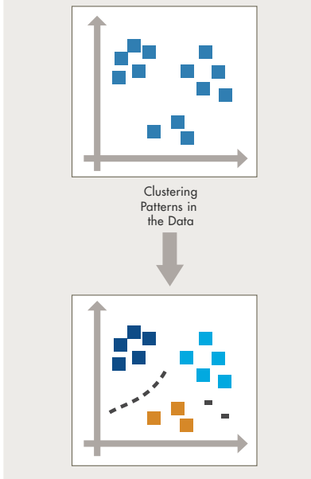

Slide 11
Thank You

